Slide 1
Social Networking Site
“SocialEyes”

Slide 2
DBMS PROJECT
Developers:
S Ilayaraja 2015 kucp 1030
Jaipal Singh 2015 kucp 1038
Chandna Tanwar 2015 kucp 1041

Slide 3
INTRODUCTION
In today’s world, social media plays a crucial role in our lives.Therefore, we intended to make a social networking site “SocialEyes” so that people can build social networks or social relations with other people who share similar personal or career interests, activities, backgrounds or real-life connections and can communicate with each other.

Slide 4
Database and Database Connection
Module 1 :

Slide 5
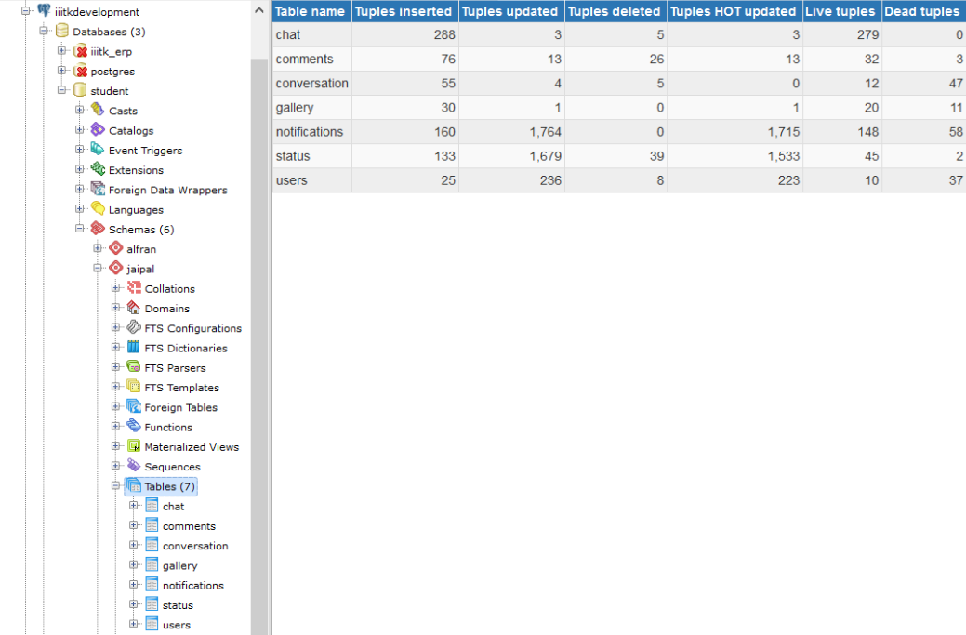
PostgreSQL

Slide 6
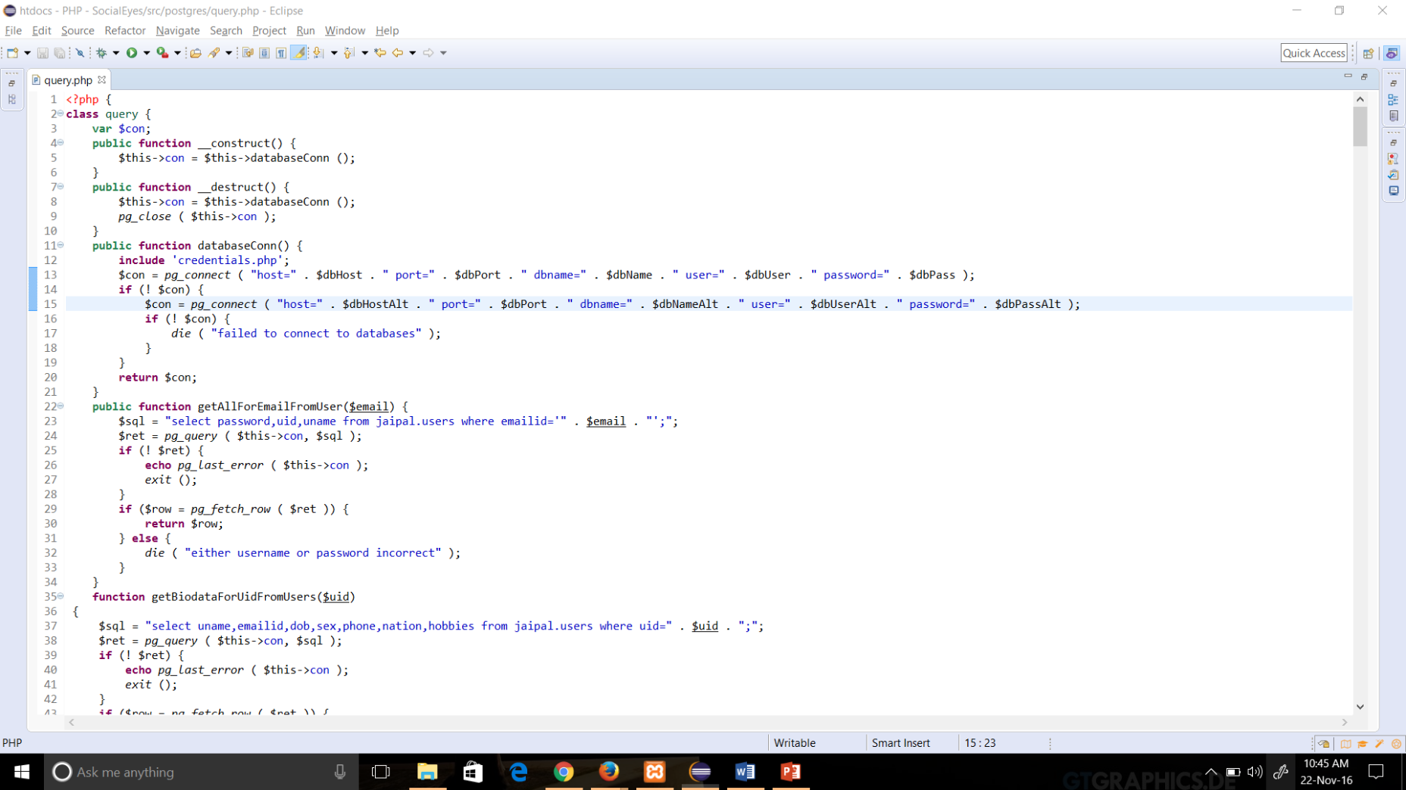
PHP and PostgreSQL connection

Slide 7
Login and Register Module
Module 2:

Slide 8
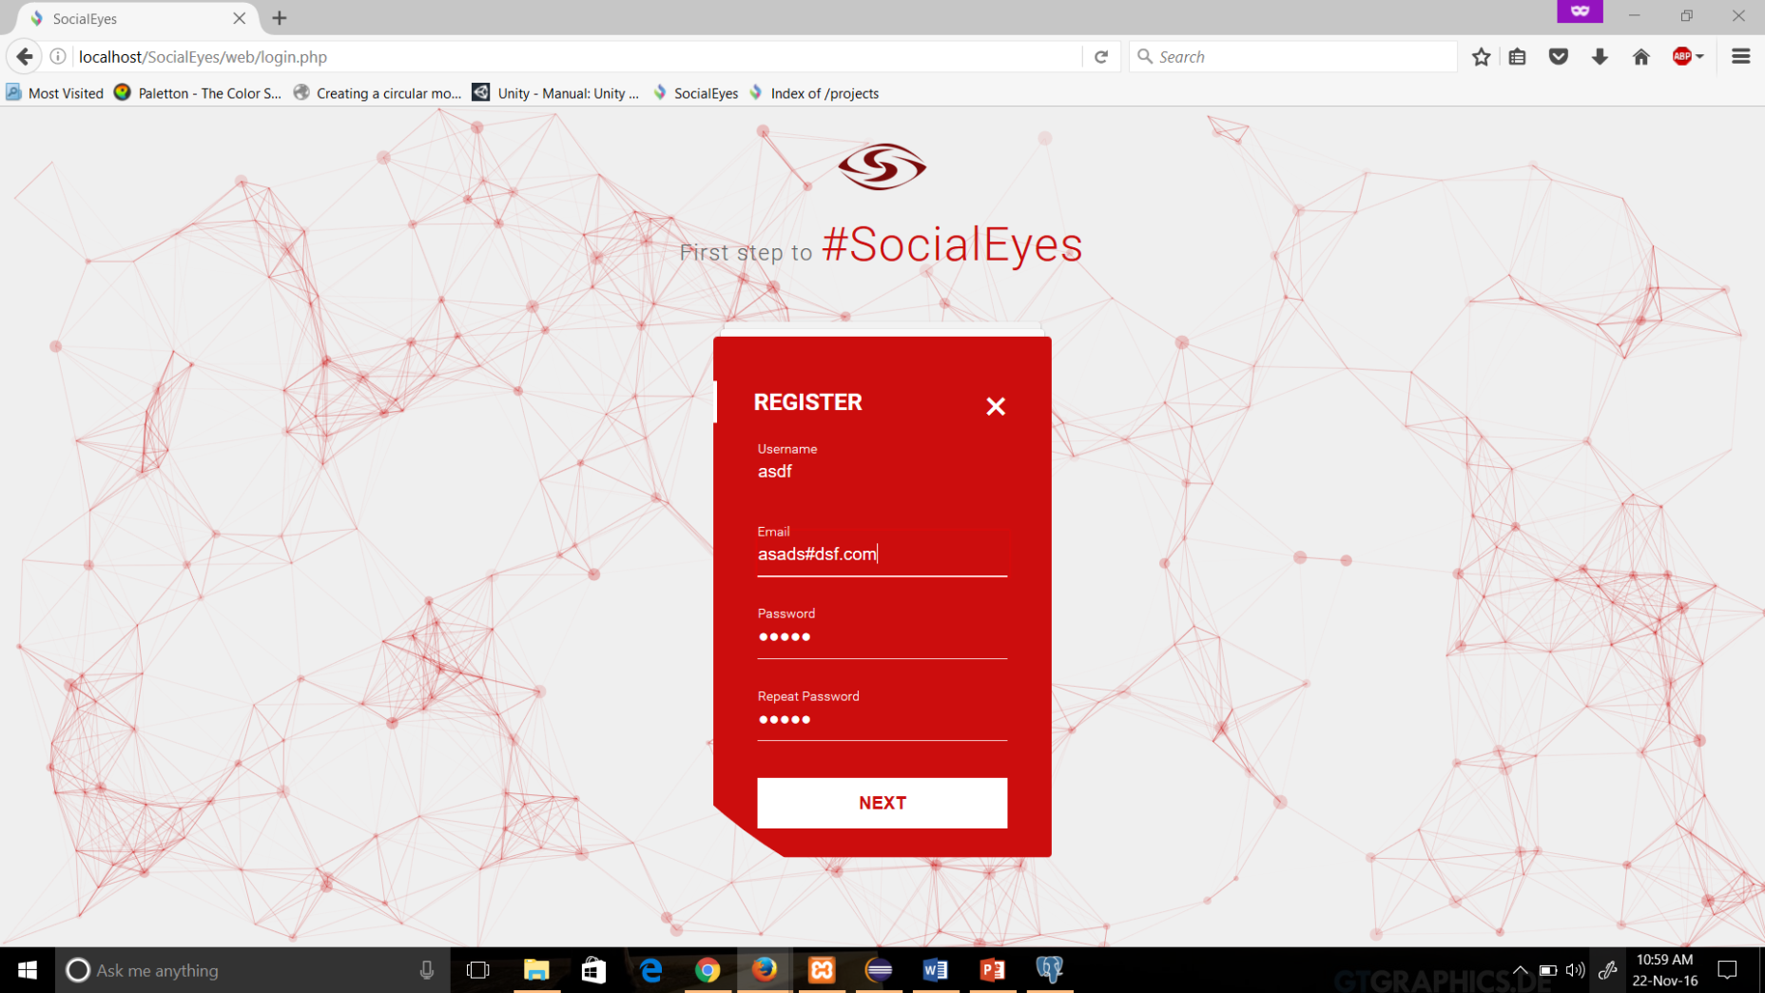
Validations

Slide 9
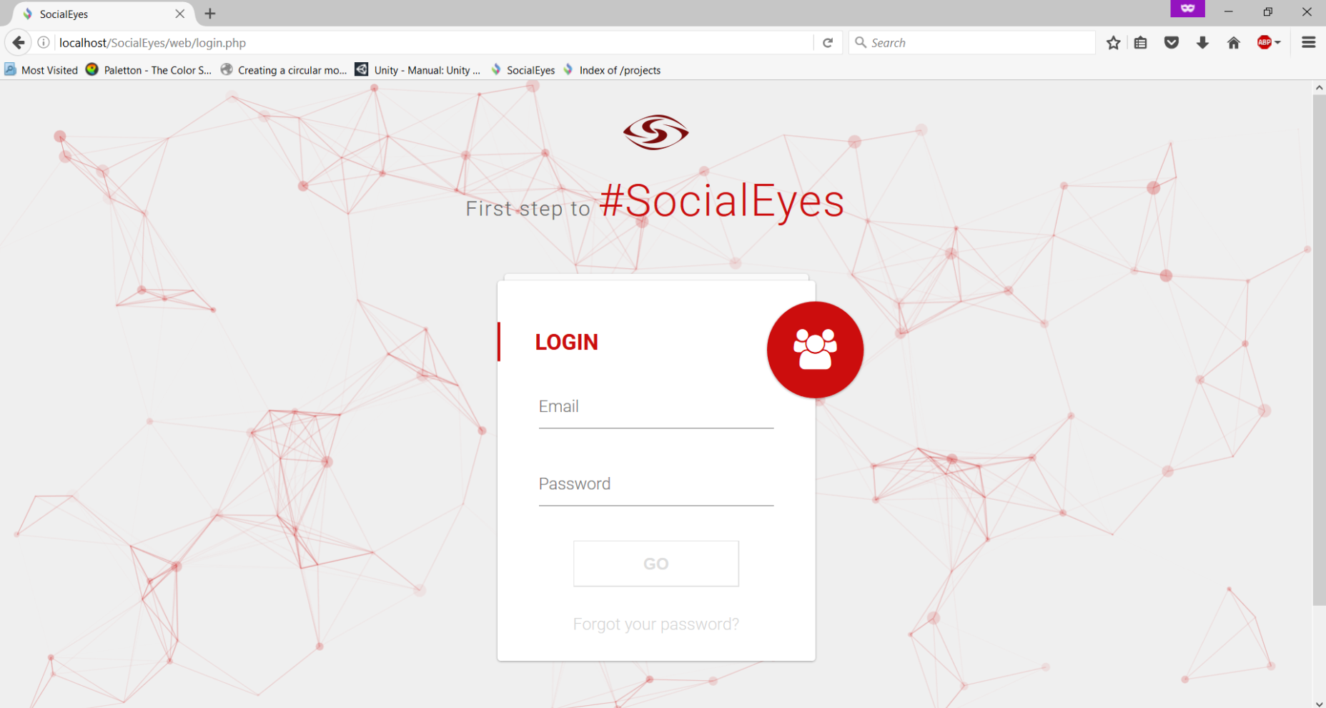
Experience of Social Eyes

Slide 10
Status
Module 3:

Slide 11
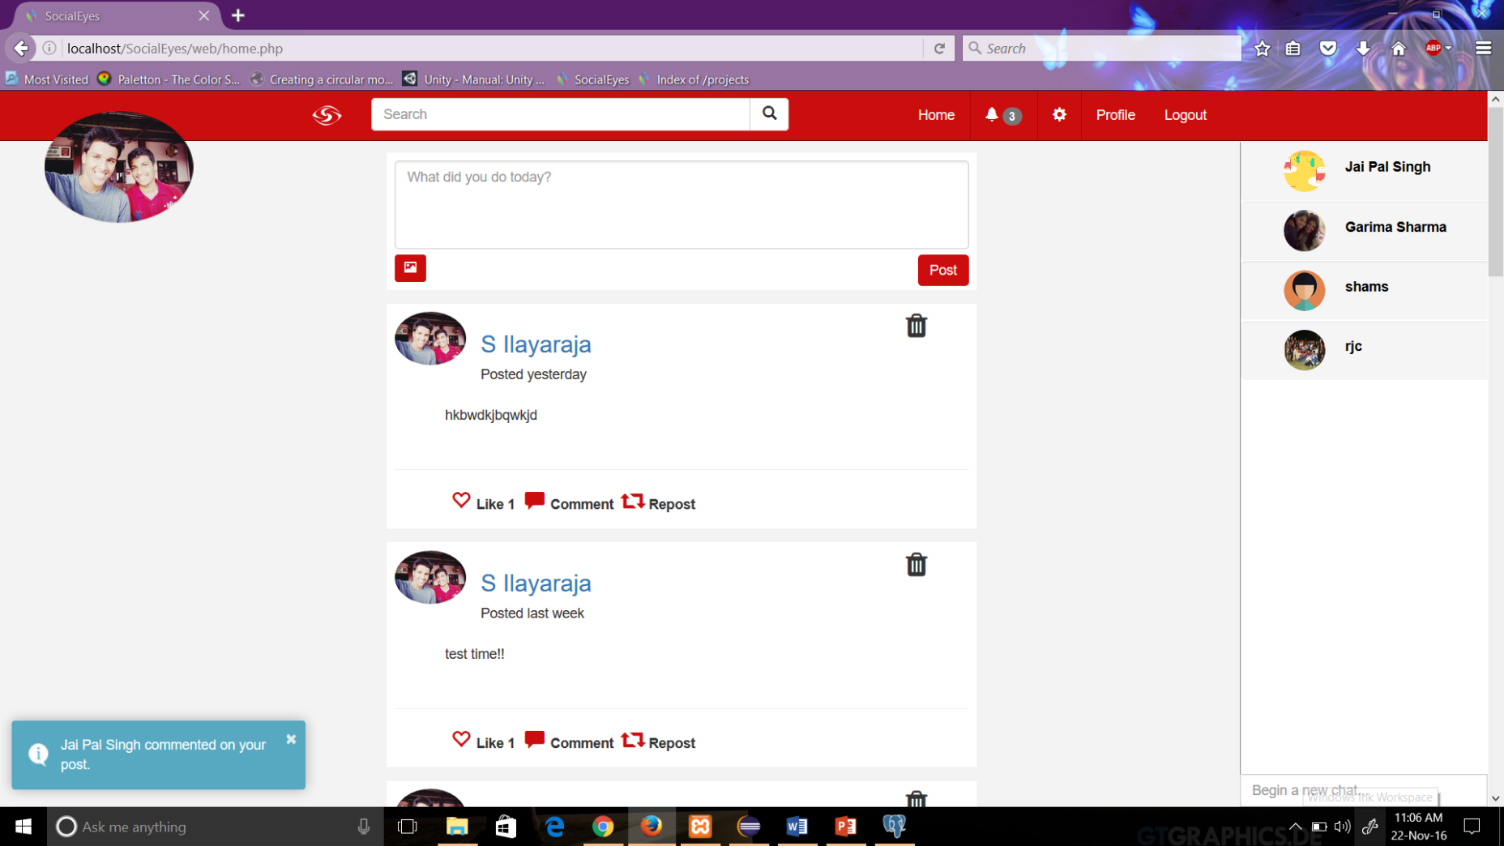
Field where user can share his /her thoughts and pictures with the people following him/her.

Slide 12
Chat
Module4:

Slide 13
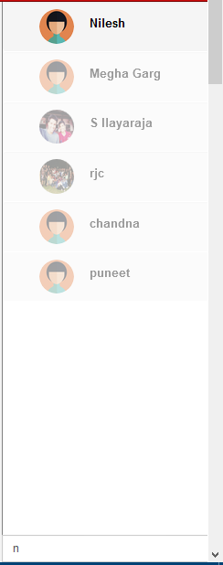
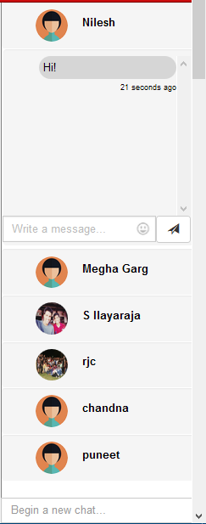
Begin to Chat

Slide 14
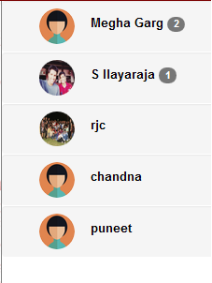
Chat Notification

Slide 15
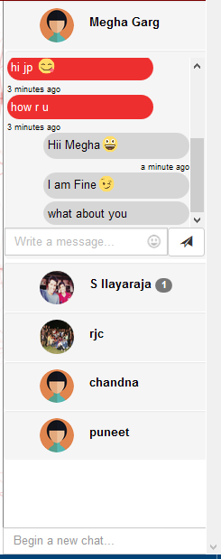
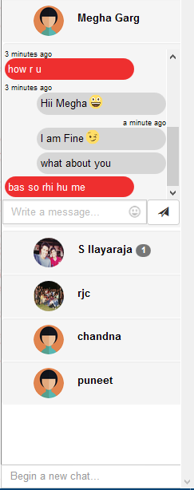
Chatting

Slide 16
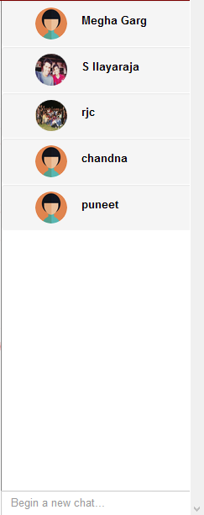
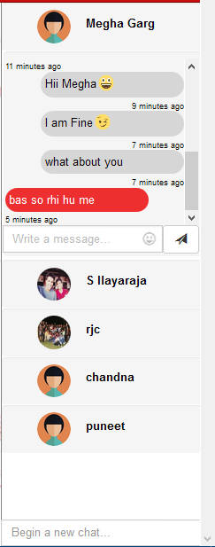
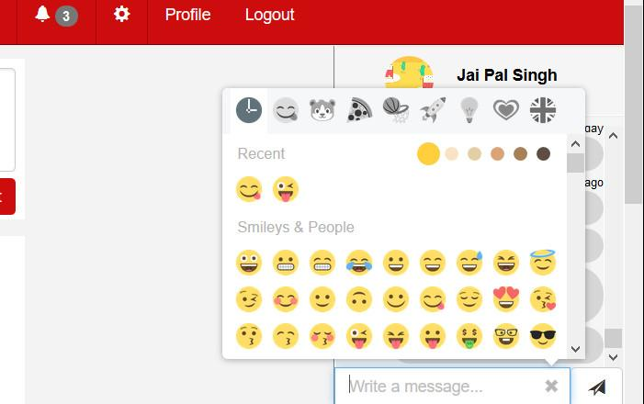
Key Features

Slide 17
LIVE SEARCH
Module 5 :

Slide 18
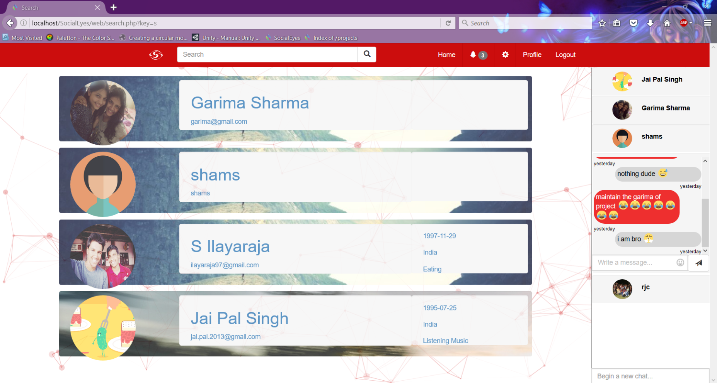
1.Feature where user can search for the persons he/she is following

Slide 19
Settings
Module 6 :

Slide 20
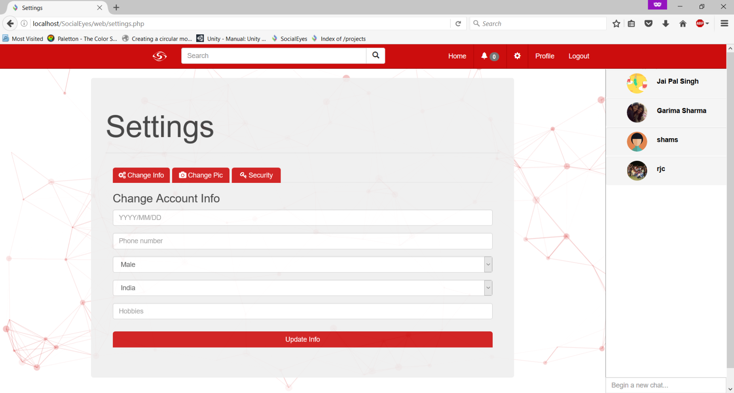
1.Can update his/her biodata
2.Can upload his/her profile pic and cover pic
3. Can change the general settings

Slide 21
GUI
Module 7 :

Slide 22
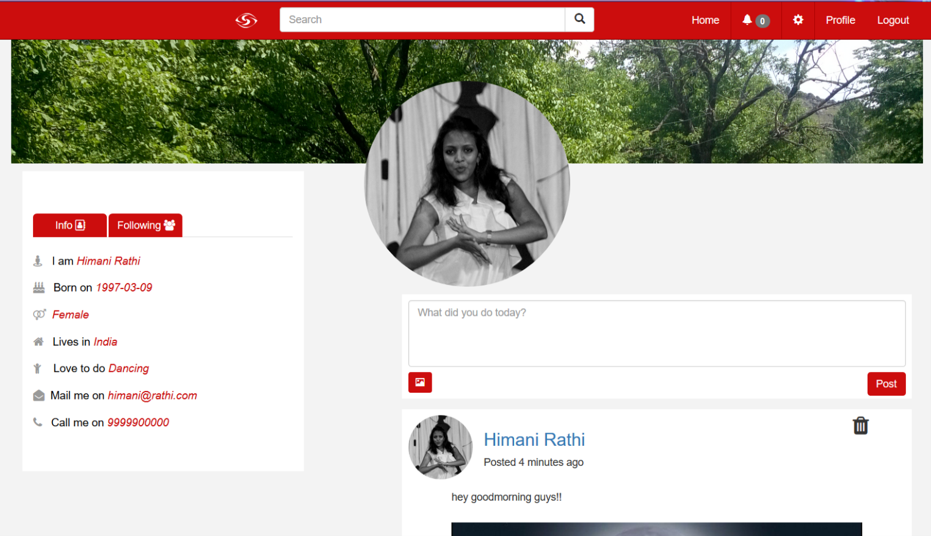
1.User friendly Graphical User Interface
2.Pages for Login/Register, Home , Profile, Search, Settings ,Followers and Following persons’ Profile.

Slide 23
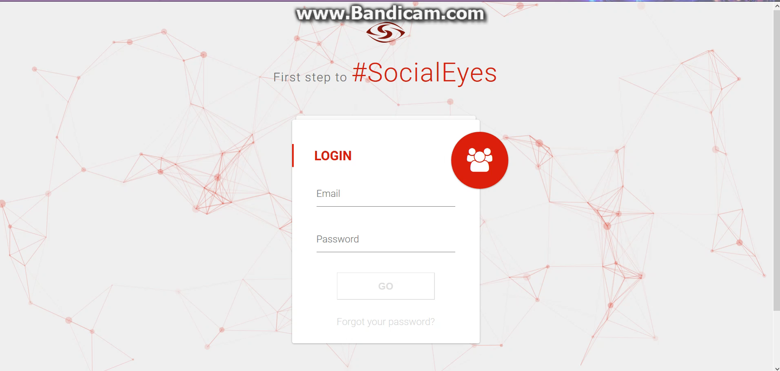
Demo of the site

Slide 24
CONCLUSION
We are very thankful to our supervisor Miss. Saroj Bijarnia for giving us an opportunity to work on such a massive project.
All of us have learnt a lot on the web technologies.

Slide 25
Integrated Projects
Emojione – This is the project made by the company emojione under the Creative Commons License hosted in github.com/Ranks/emojione was used to bring life to our project’s chat module.
Emojionearea - This is the project made by the company Meverick under the MIT License hosted in github.com/meverick/emojionearea was used to show the very unique emoji picker.
Toastr – This is the project made by CodeSeven under the MIT License to include a javascript library to show toast notifications.
Font Awesome 4.7 – Project made by Font Awesome under the SIL OFN 1.1 Licence. Used to use visually appealing glyphicons.
Jquery.form-validator – jquery plugin to validate forms.
Particles-js – to increase the general visual appeal of the site.

